Slide 1

IST 687 - Group 3 -Movies Data Set
Team Members: Adam Vajdak, Adriana Nowrouzi, Edna Navarro, Tyler Brandon, Gabrielle Iacona

Slide 2
Table of Contents:
Introduction to Dataset
Explore Dataset/ Descriptive Statistics
Graph Data to Understand Distribution/ Additional Bar Plots
Variables Trended Over time
Understand Correlations
Regression Analysis
Final Model Selection

Slide 3
Introduction to Dataset
Data Set:https://kaggle.com/datasets/rounakbanik/the-movies-dataset?select=ratings_small.csv
21 Columns
Id, title, adult, belongs to collection, budget, original language, popularity, release date, revenue, runtime, status, vote count, main production company, top production country, top genre, genre 2, genre 3, genre 4, genre 5, genre 6, vote average
5381 Rows
Date range: 1915 - 2017
Data Set Requirements:
At Least 10,000 Points of Data
The data set contains 45,467 movies, 26 columns, and over 26 million ratings, creating over 100 million points of data
At Least 10 Columns
The data set contains 26 columns of information

Slide 4
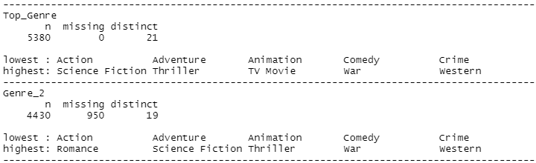
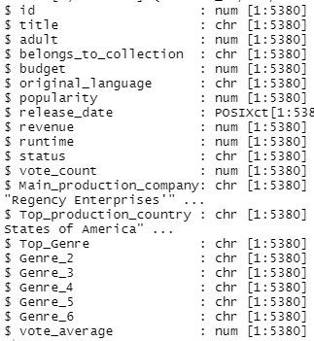
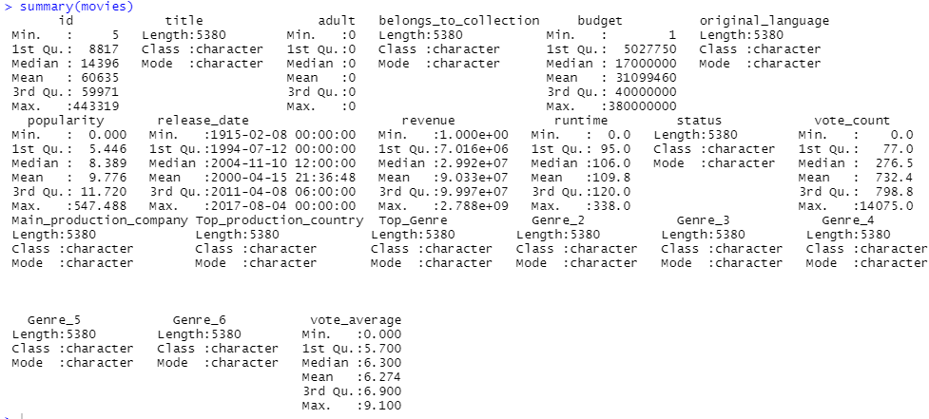
Explore Dataset/ Descriptive Statistics
Understand the structure
Explore Min, Max, Median of numeric attributes etc.
Understand NA’s, Distinct Responses, Highest and Lowest Responses

Slide 5
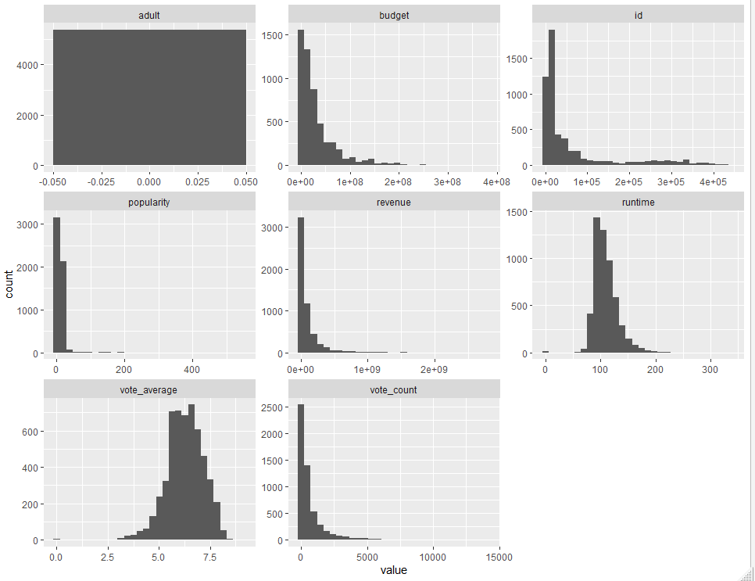
Graph Data to Understand Distribution/ Additional Bar Plots
Plotted histograms on numeric attributes
Budget, Popularity, Revenue, & Vote Count skewed right
Runtime & Vote Average appear to be normally distributed
Id and adult variables do not add additional value

Slide 6
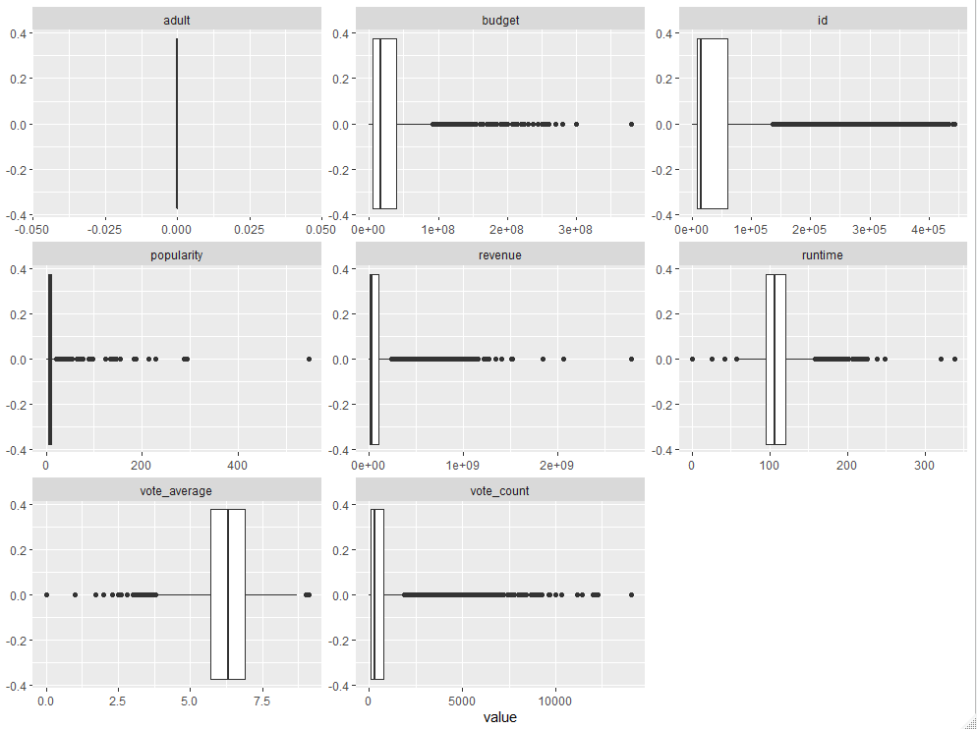
Plotted boxplots on numeric attributes
Almost all attributes appear to have a wide range
Potential outliers evident in all attributes

Slide 7
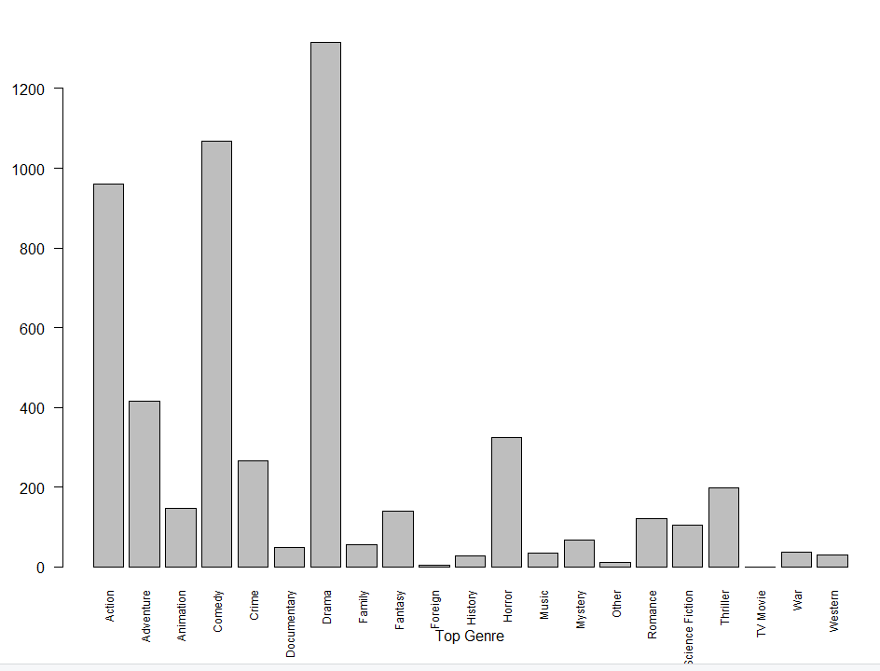
Drama, Action, and Comedy are the top 3 genres
TV Movie, Foreign, and Other are bottom 3 genres

Slide 8
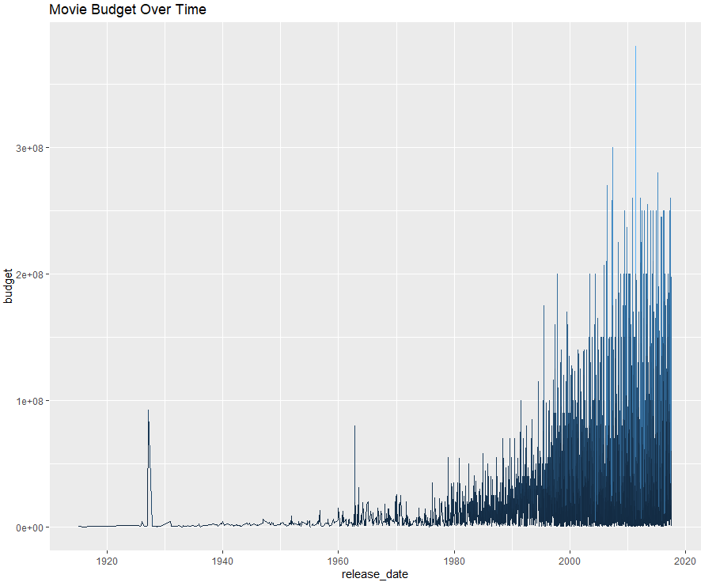
Variables Trended
Y- axis: Movie Budget
X-axis: Release Date
As movies became more recent, the movie (on average) budget increased

Slide 9
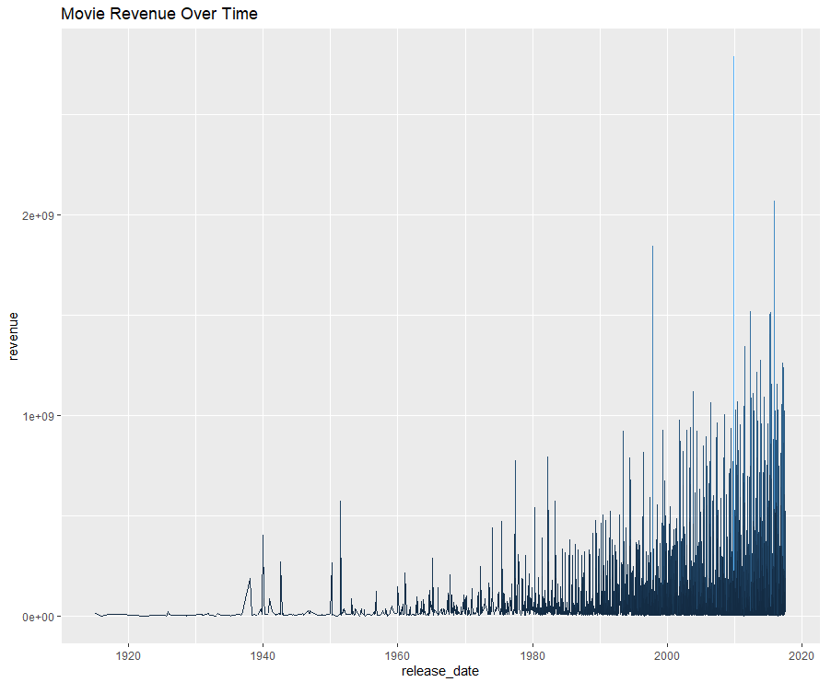
Variables Trended
Y- axis: Movie Revenue
X-axis: Release Date
As movies became more recent, the movie (on average) Revenue increased

Slide 10
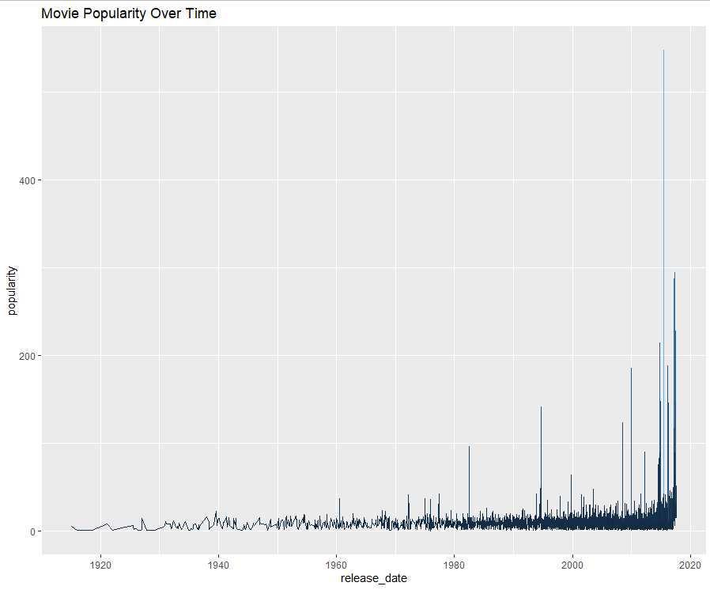
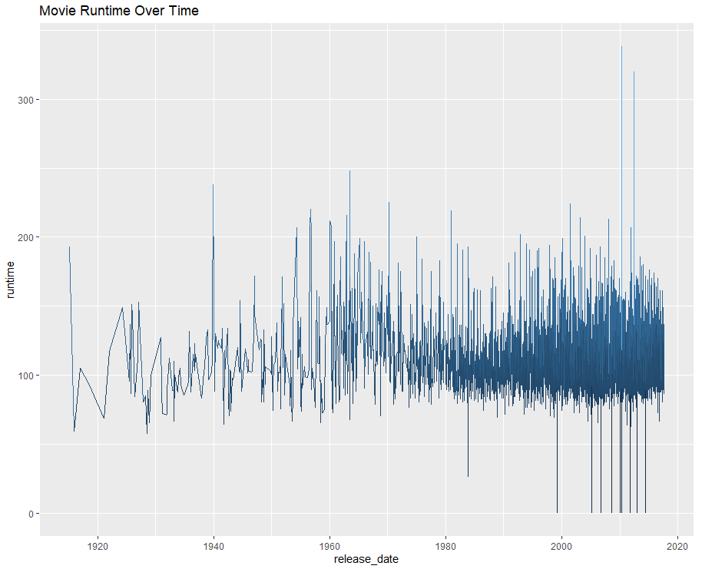
Y- axis: Popularity
X-axis: Release Date
As movies became more recent, the movie (on average) popularity increased
Y- axis: Run time
X-axis: Release Date
As movies became more recent, the movie (on average) runtime range increased. However, they tend to oscillate around 115

Slide 11
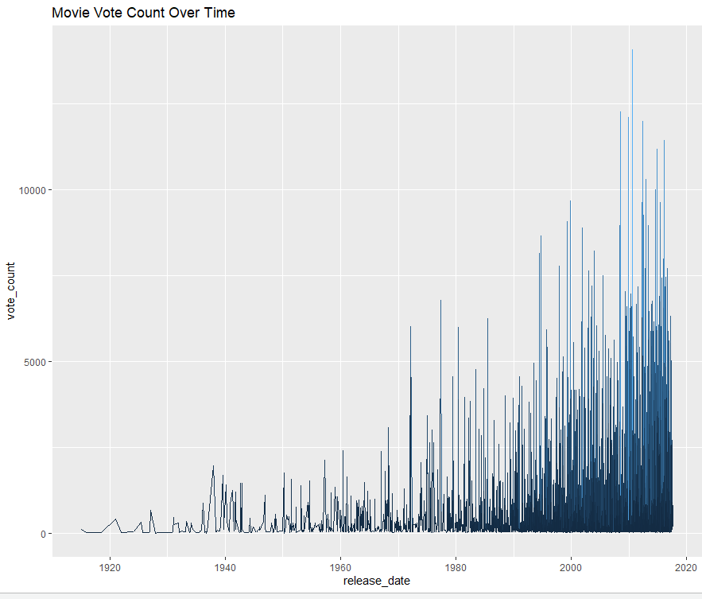
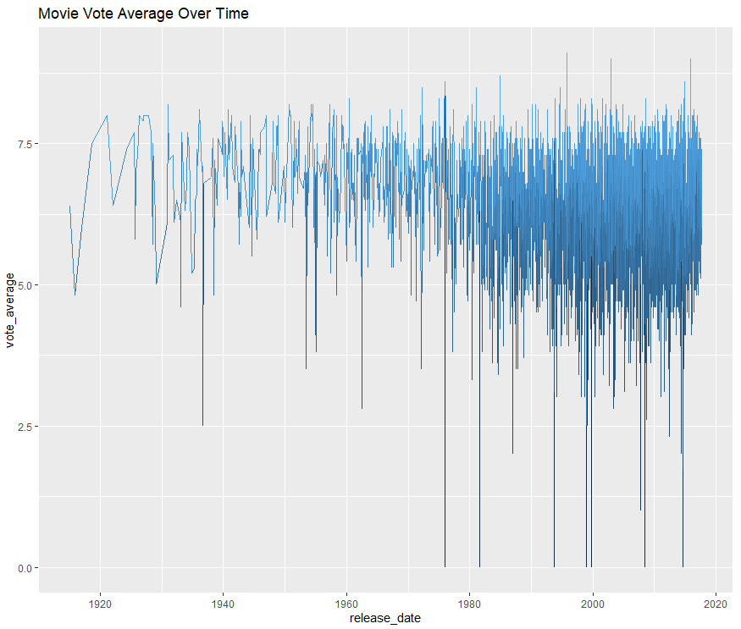
Y- axis: Vote Count
X-axis: Release Date
As movies became more recent, the number of movie counts (on average) increased
Y- axis:Vote Average
X-axis: Release Date
As movies became more recent, the movie vote average appears to be trending downwards, with a center of 6.25

Slide 12
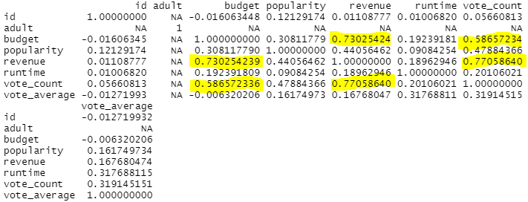
Understand Correlations
Strongest Correlations (Descending)
Vote Count & Revenue
Revenue & Budget
Vote Count & Budget

Slide 13
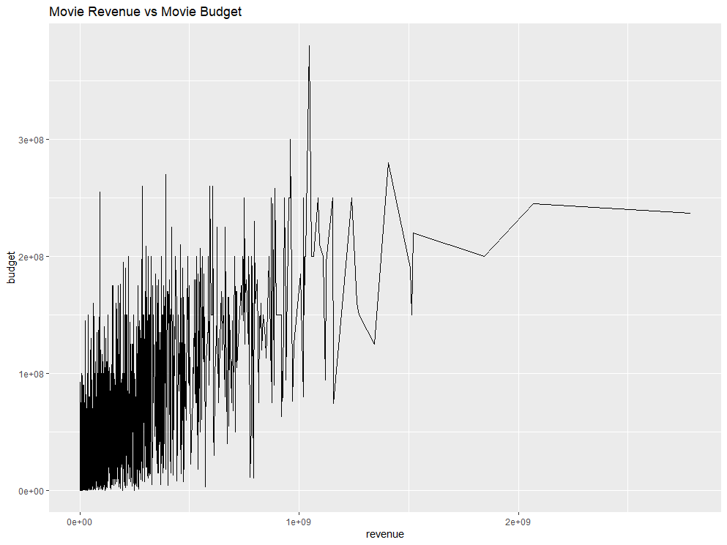
Plot Line Graphs to Understand Strong Correlations
As the movie budget increases, it appears that movie revenue (on average) also tends to increase

Slide 14
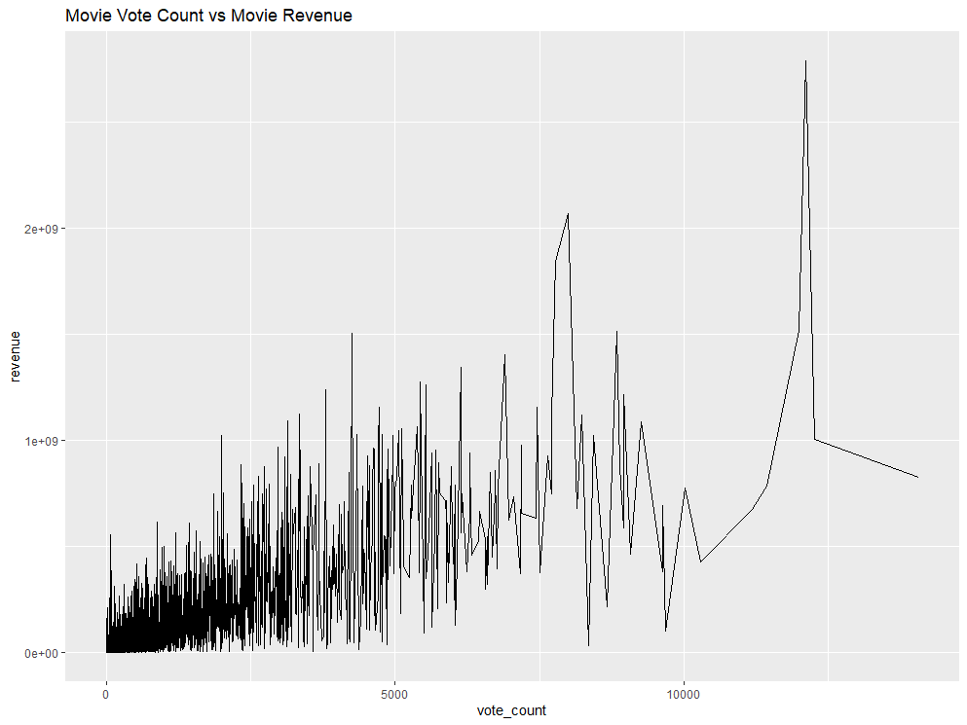
Plot Line Graphs to Understand Strong Correlations
As the movie revenue increases, it appears that the vote count (on average) also increases

Slide 15
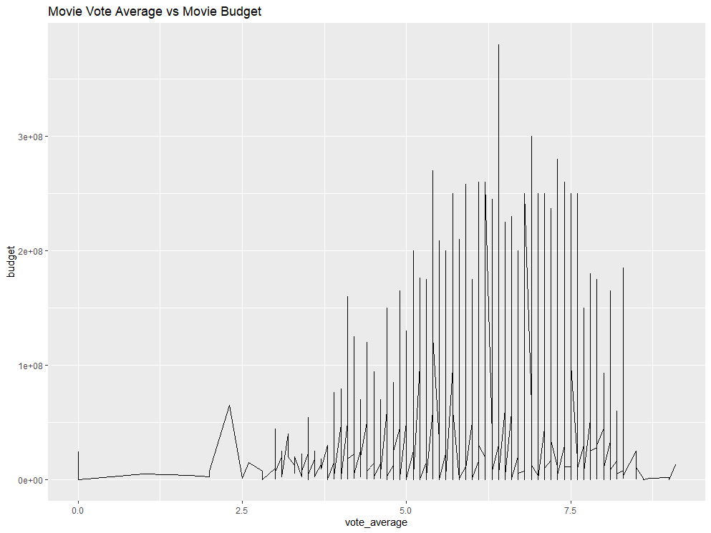
Plot Line Graphs to Understand Strong Correlations
As the movie budget increases, it appears that the vote average has a normal distribution curve
The highest voted movies do not necessarily have the highest budget
The highest budgeted movie has a vote average or 6.25

Slide 16
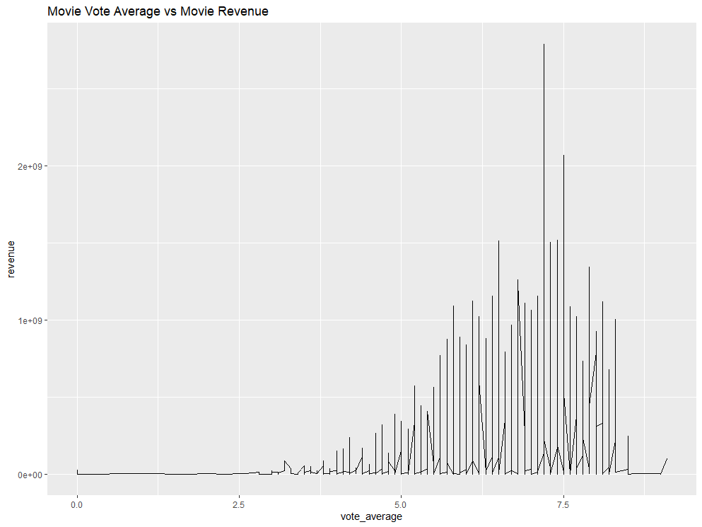
Plot Line Graphs to Understand Strong Correlations
On average, as the vote average increases, the movie revenue tends to also increase
However, the highest revenue movie does not have the highest vote average

Slide 17
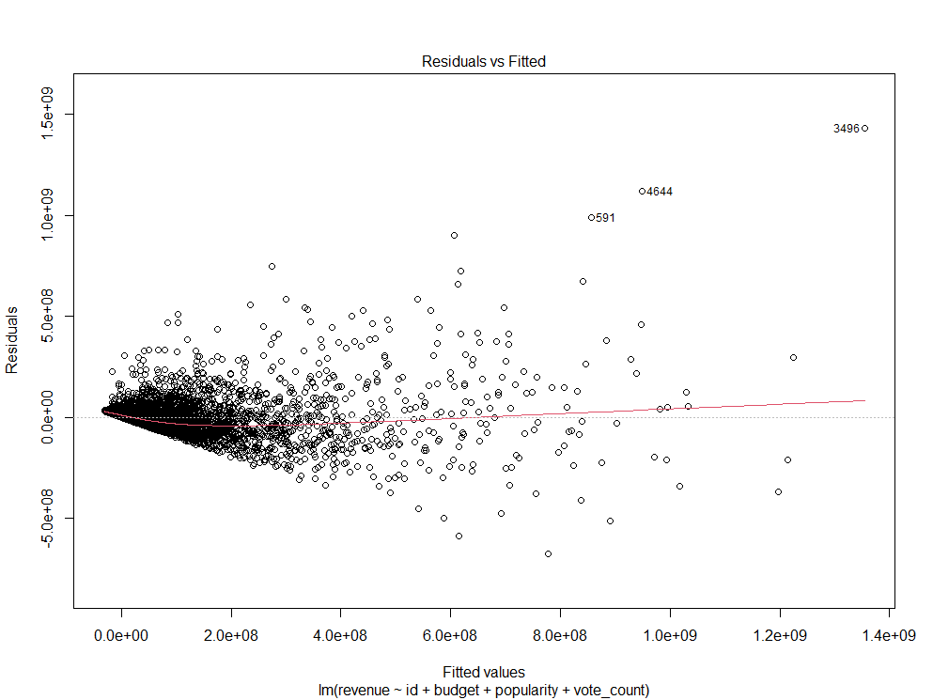
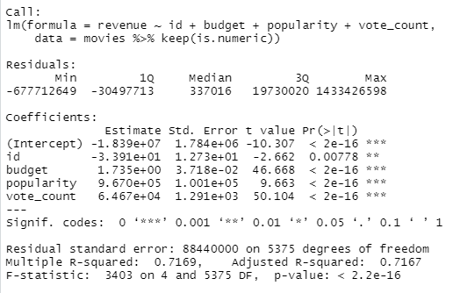
Regression Analysis
Model 1: Revenue as dependent variable

Slide 18
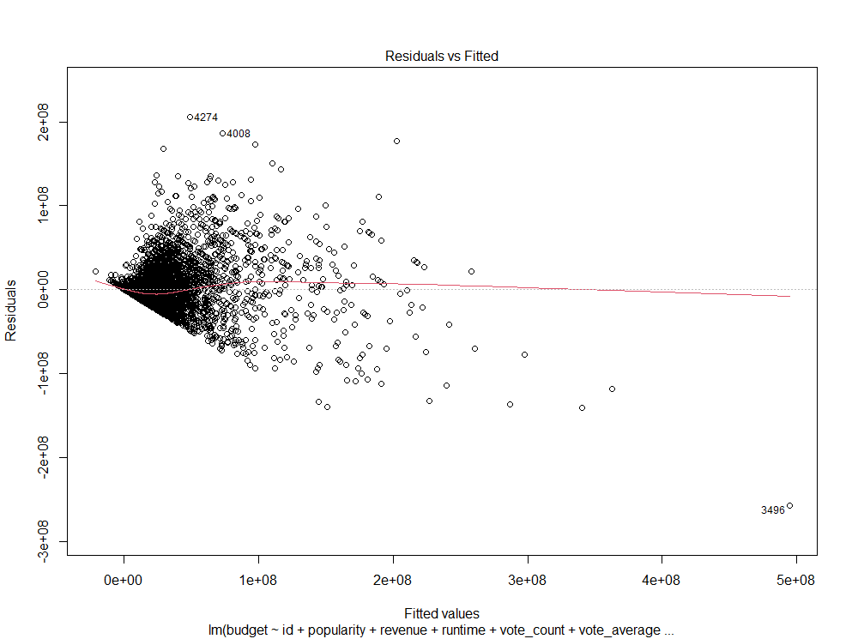
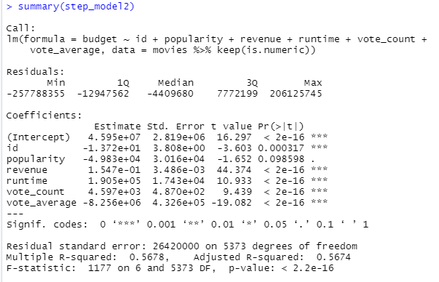
Regression Analysis
Model 2: Budget as dependent variable

Slide 19
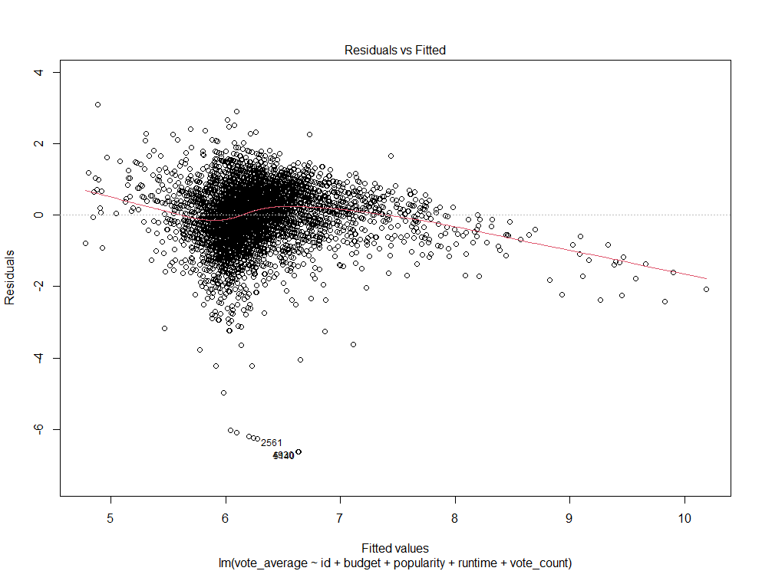
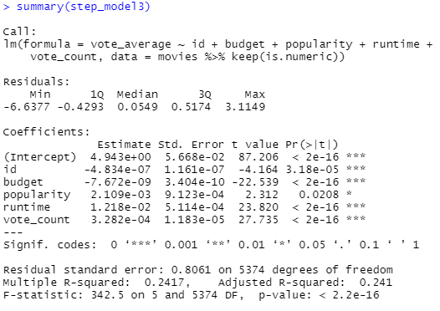
Regression Analysis
Model 3: Vote Average as dependent variable

Slide 20
Regression Analysis: Final Model Selection
 | Model 1 | Model 2 | Model 3
P-Value | < 2.2e-16 | < 2.2e-16 | < 2.2e-16
Adjusted R Squared | 0.7167 | 0.5674 | 0.241
Model 1: (Formula = Revenue ~ ID + Budget + Popularity + Vote_count), is the best model given that it produced the highest Adjusted R Squared. This means that 72% of the volatility in the Movie revenue can be explained by the attributes included in this model.

Slide 21
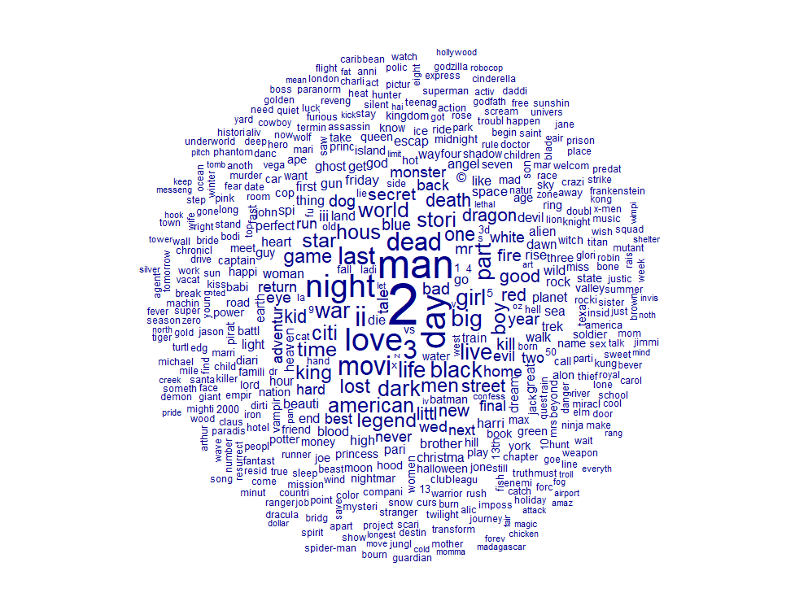
For Fun: World Cloud
Most common words used in Movie Titles, min term frequency 2

Slide 22
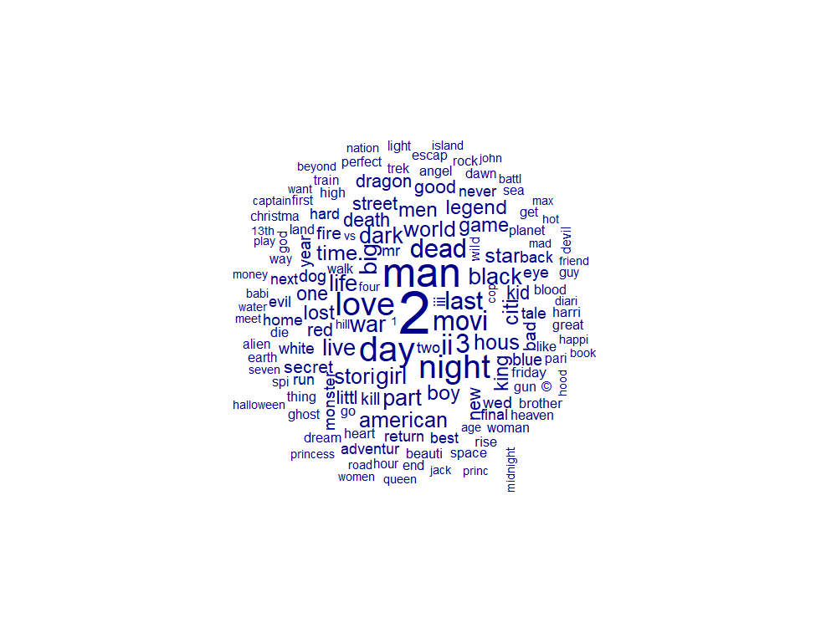
For Fun: World Cloud
Most common words used in Movie Titles, min term frequency 10

